Slide 1

ASSIGNMENT – FT 315
FOOD PROCESS EQUIPMENT DESIGN
DESIGN OF VACCUM DRYER
SUMBITTED BY- SHREYA MAURYA
ID NO. - 21212BTF023

Slide 2
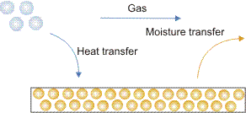
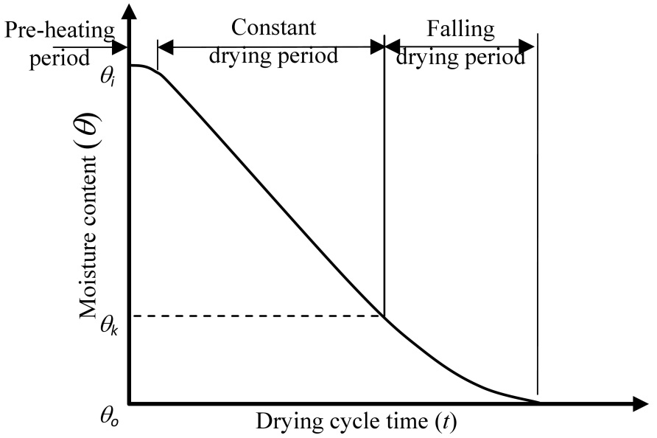
INTRODUCTION
WHAT IS DRYING?
Drying is a mass transfer process consisting of the removal of water or another solvent by evaporation from a solid, semi-solid or liquid.
Drying involves two distinct drying periods, known as the constant drying period and the falling drying period.
Drying occurs when liquid is vaporized by supplying heat to the wet feedstock.
The liquid removed by the drying process could be either free moisture (unbound) or bound within the structure of the solid. The unbound moisture, normally present as a liquid film on the surface of a solid particle, is easily evaporated, while the bound moisture could be found within the solid material, trapped in the microstructure of the solid. In this case, the moisture must travel to the surface to be evaporated.
Notes:
Reference no. 1

Slide 3
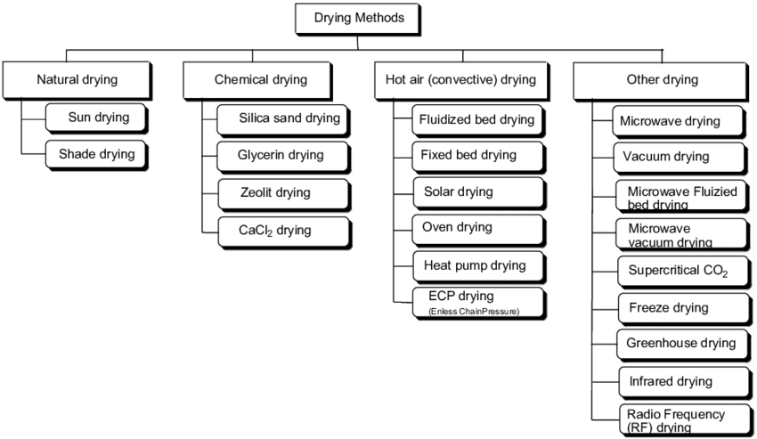
Notes:
Reference no. 2

Slide 4
WHY VACCUM DRYING?
PURPOSE?
WHAT HAPPENS?
The main purpose of vacuum-drying is to allow the removal of moisture under vacuum and hence at a lower temperature condition and oxygen content . Vacuum-drying is therefore suitable for heat- and oxygen-sensitive materials.
Samples that undergo vacuum drying are less likely to become contaminated, oxidized, or react with water.
During vacuum-drying, the rate of evaporation increases (at a fixed temperature) since the boiling point of water decreases with a decrease in pressure, for instance at a pressure of 0.1 bar, the vaporization temperature is almost equal to 45°C.
In addition, effective hydraulic conductivity of a material increases under vacuum, so the resistance to mass transfer at the product surface reduces.
Notes:
Reference no. 4 and 7

Slide 5
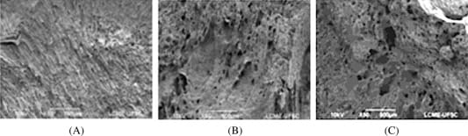
COMPARISION WITH HOT AIR DRYING
MICROSTRUCTURE DIFFERENCE
EXAMPLE
Microstructure of food materials dried by vacuum-drying is generally identified as having a higher porosity (compared to that of a material dried by hot air), resulting in less shrinkage and having higher rehydration and reconstitution capabilities.
Porosity and pore size of the vacuum-dried product were higher and larger than those of the hot air dried product by about 14%.
The microstructure of the banana slices dried by hot air (60°C) and vacuum-drying (60°C, 1.5 kPa) are illustrated in Fig.
Scanning electron microscopy images of (A) fresh; (B) hot air dried; and (C) vacuum dried banana chips.
Notes:
Reference no. 3

Slide 6
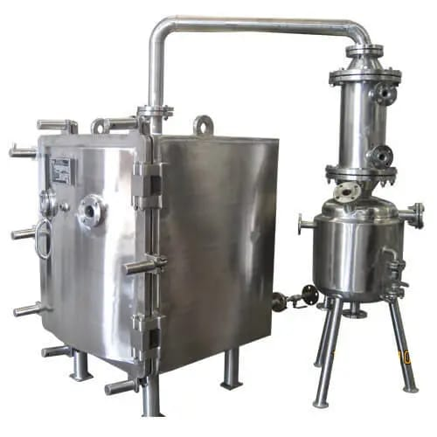
CONSTRUCTION
Vacuum Tray Drying Parts -
Suitable Size Condenser & Receiver in SS 316/304 to Condensate Collection.
Circulation pump with FLP Motors and controls
Vacuum Pump consisting of FLP motor
PLC controller
Nitrogen purging valve
Validation ports w/ sensors
IQ / OQ / DQ / PQ Certifications
Notes:
Reference no. 5 and 6

Slide 7
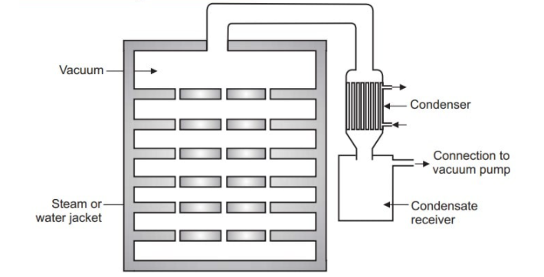
FABRICATION
A vacuum dryer consists of a chamber divided into hollow trays or shelves, which increase the surface area for heat conduction. Internal and external both chambers of these Vacuum Tray Dryers are made of high grades stainless steel, of grade SS 304 / SS 316 / SS 316L.
The oven door is designed to be airtight and connected to a vacuum pump to reduce the pressure inside. Doors made of MS / SS 304 / 316 / 316L with thick layer interlock & glass wool insulation.
The material to be dried is placed on the trays inside the dryer, and the pressure is lowered using the vacuum pump.
The oven is also connected to a condenser to collect the evaporated moisture.
Notes:
Reference no. 5 , 6 and 8

Slide 8
WORKING MECHANISM
Material placed in trays , kept in chamber
Vacuum is applied, door closed
Hot air introduced
Vapours passed through condenser
The materials to be dried is spread on trays. The trays are placed on the shelves.
Vacuum is applied so pressure will be decreases up to 30-60 kilopascals. Because of that boiling point of the liquid decreases so that the liquid will boils at low temperature than its BP.
After applying vacuum, door is closed firmly.
Steam or hot air is introduced in to the hollow space of jacket and shelves.
Heat transfer takes place by conduction. So that water will be evaporated from the material at 25-30 °C because of the lowering of the BP.
Water vapor passes in to the condenser where condensation takes place. At the end of the drying vacuum line is disconnected.
The dried material is collected from the trays.
Notes:
Reference no. 5 and 6

Slide 9
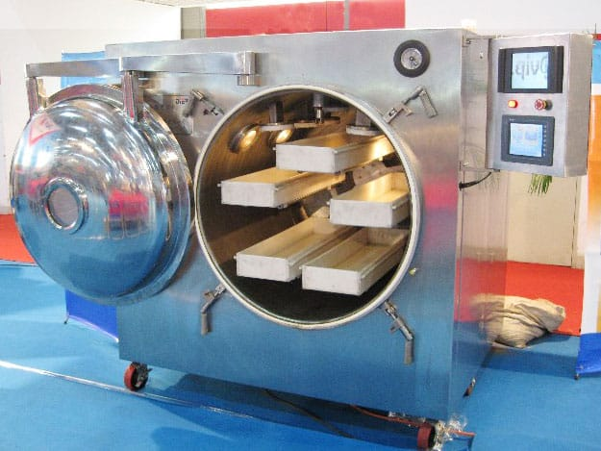
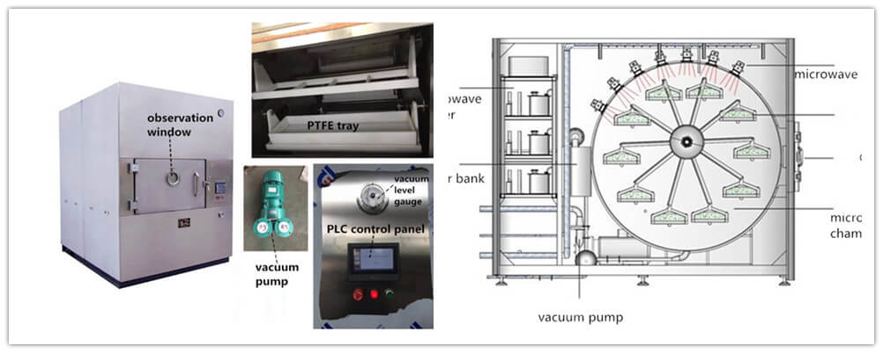
OTHER TYPES
MICROWAVE VACUUM DRYER
Notes:
Reference no. 9 and 10

Slide 10
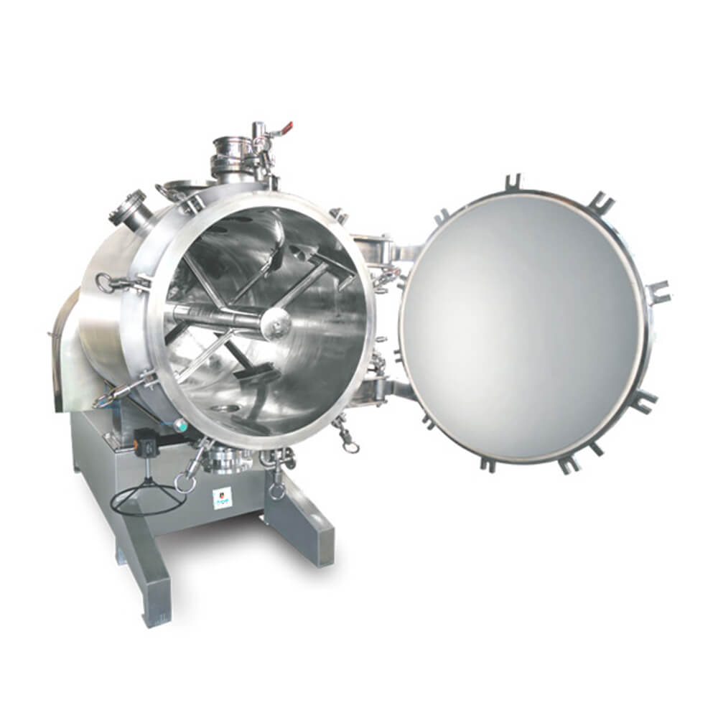
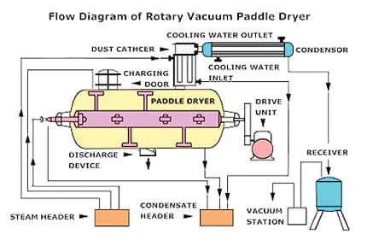
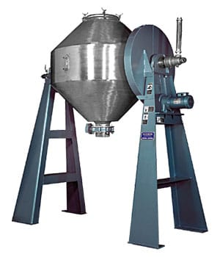
OTHER TYPES
ROTARY VACUUM DRYER
DOUBLE CONE VACUUM DRYER
AGITATED VACUUM DRYER
Notes:
Reference no. 11 , 12 and 13

Slide 11
MORE ABOUT VACUUM DRYER
Type of industries - Chemical, pharmaceutical, food, and plastic industries are just a few industries that use vacuum drying equipment.
Type of operation - The process typically involves removing and recovering solvents from moist material, or removing water from a moist material and recovering its solvents.
Changing physical state - Phase changes occur when a material's molecular and physical chemistry is modified by a chemical reaction or polymer solid state.
Separation - Vaporization of a material is typically used to separate volatile liquids from powders, cakes, slurries, or other moist materials.
Safety - It is safer to work near a vacuum dryer since there is no need for ventilation. During the drying process, the precipitated moisture that has been collected can also be utilized.
PRODUCTS | DRYER TYPE
Pistachios | Vacuum- Infrared
Eggplants | Vacuum
Probiotics | Ultrasonic vacuum spray dryer
Chilies | Combined microwave- vacuum rotary drum dryer
Cranberries | Microwave- vacuum dryer
Fruit and vegetables | Microwave- vacuum dryer
Fruit (general) | Microwave
Notes:
Reference no. 1 and 6

Slide 12
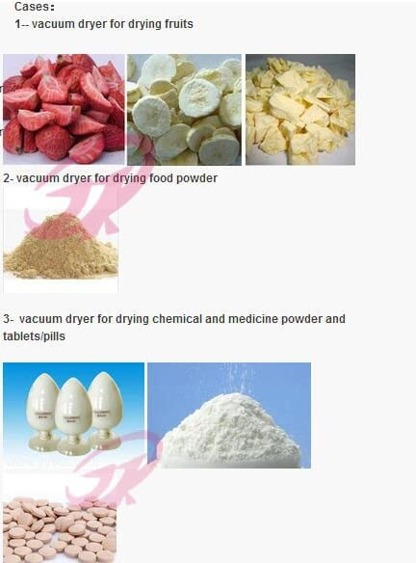
APPLICATION
Drying pharmaceuticals - In the preparation of mouth-dissolving tablets, granules containing Nimesulide, camphor, crospovidone and lactose are prepared by a wet-granulation technique. Camphor was sublimed from the dried granules by exposure to vacuum. The porous granules were then compressed.
Drying proteins – Used as a alternative to lyophilization in the formulation of proteins as dry powders. Mannitol is often added to dried protein formulations as the bulking agent because it has the tendency to crystallize rapidly from aqueous solutions.
Notes:
Reference no. 1 and 6

Slide 13
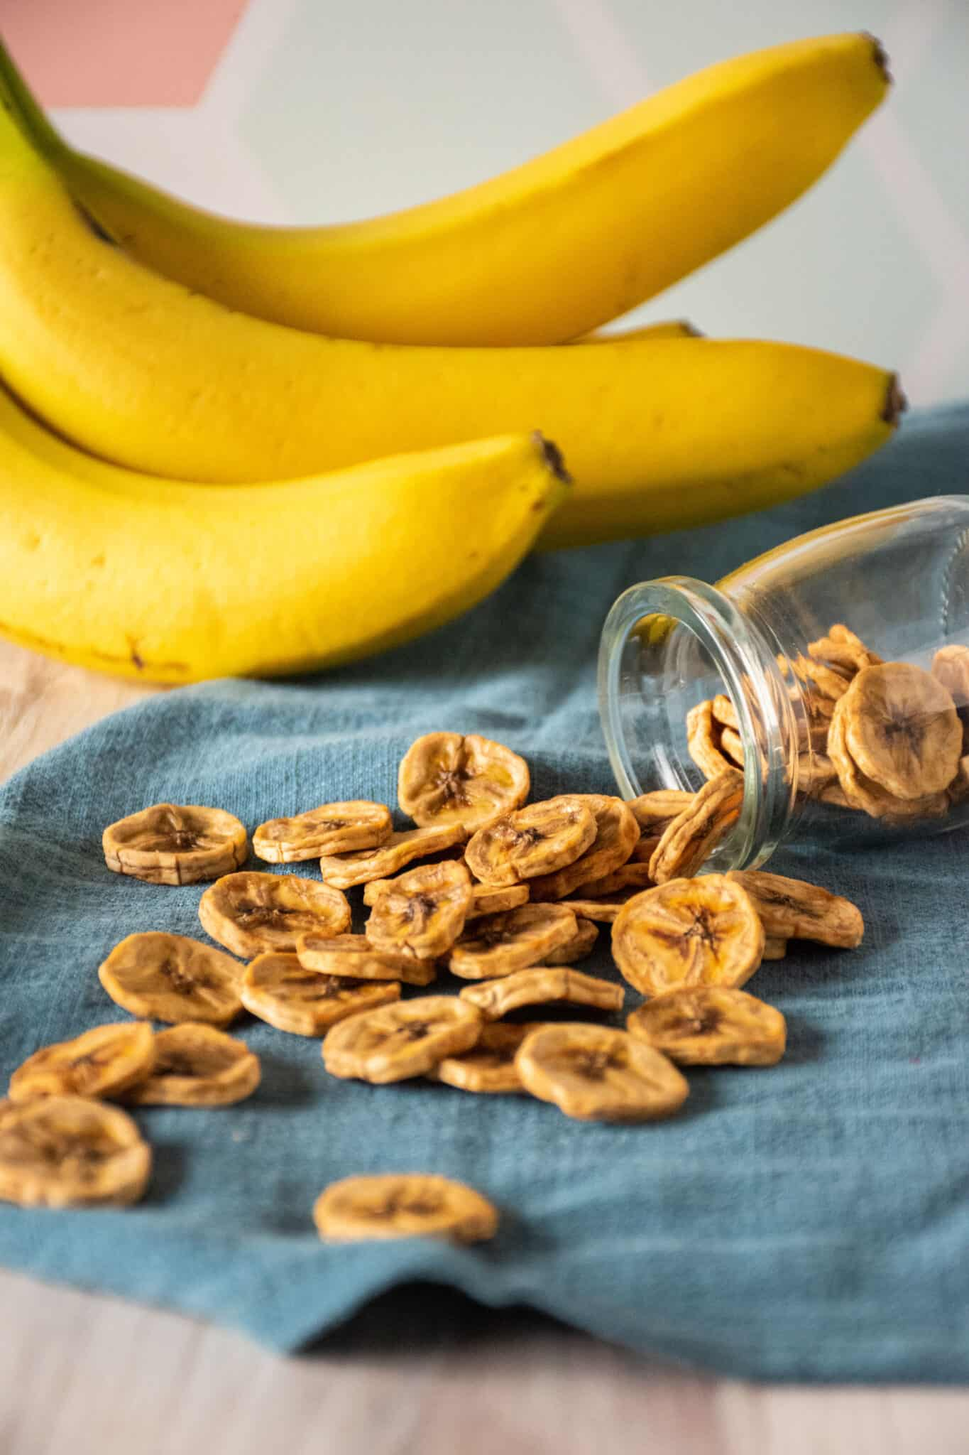
APPLICATION
Drying fruits and vegetables – Fruit slices with thickness 2mm to 9mm selected from banana, pineapple, mango, papaya, apple, pear and some of the vegetables are vacuum dried.
By using pulsed-microwave vacuum drying, researchers have been able to dry cranberries and mint leaves.
Mint Leaves-
The effective moisture diffusivity was significantly increased when microwave drying was applied under vacuum conditions, compared with hot-air drying.
For color, the microwave-vacuum-dried mint leaves were light green/yellow, whereas the hot-air-dried mint leaves were dark brown.
Notes:
Reference no. 1 and 6

Slide 14
MERITS
The vacuum dryer is designed to dry thermo labile materials at low temperatures as well as to recover solvents from solid products containing solvents.
By removing a large amount of moisture compared to typical dryers, materials can be dried in final containers or enclosures.
Typical vacuum dryers have lower average drying temperatures and the quality of dried material is superior to that of normal dryers.
A large surface area makes it easier for heat to be transferred throughout the dryer, thus providing faster drying action.
Efficient heat transfer
Uniform drying process
Good solvent recovery capacity
Less time cycle for one batch process
Reduced power consumption
Less hazard at work place
Notes:
Reference no. 6

Slide 15
MERITS
Its energy conservation is a major advantage. For storage, sale, or other purposes, drying a product requires less energy. This reduces economic and environmental costs.
Other drying methods take a lot longer than vacuum-drying.
Generally, this operation is carried out in batches, but it is also possible to integrate it into a continuous process.
Automated discharge of product with condenser of moisture and recovery of solvents.
The equipment reduces the risk of workers being sick or having to wear protective clothing from vented fumes and particles.
Efficient heat transfer
Uniform drying process
Good solvent recovery capacity
Less time cycle for one batch process
Reduced power consumption
Less hazard at work place
Notes:
Reference no. 6

Slide 16
DEMERITS
Drying by vacuum is typically a batch process that is inefficient.
There is a high cost associated with vacuum dryers, and skilled labor is needed to operate them.
Maintenance costs are relatively high.
In contrast to direct-heat dryers, its maximum temperature limit is lower (typically around 600 °F). As a result, a vacuum dryer's ability to raise material temperature is also limited.
Limited production- Batch process
Specialized and Skilled labor
Maintenance cost high
Limited maximum temperature
Risk of overheating
Lower efficiency
Notes:
Reference no. 6

Slide 17
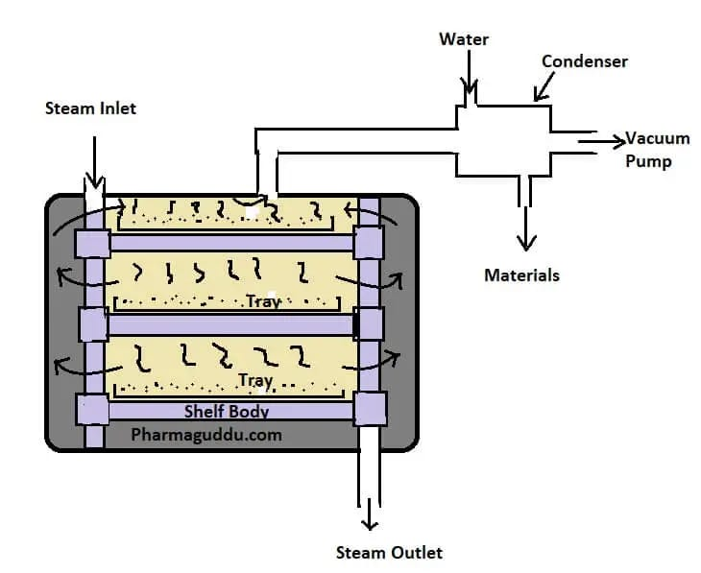
CONCLUSION
Vacuum drying is generally used for the drying of substances that are hygroscopic and heat-sensitive, and is based on the principle of creating a vacuum to decrease the chamber pressure below the vapor pressure of the water, causing it to boil.
A vacuum drying system consists of a vacuum chamber, a mechanical vacuum pump with gauge and valves as well as a source for providing heat to the product to be dried.

Slide 18
CONCLUSION
Vacuum drying can provide several benefits. Because vacuum drying controls atmospheric pressure, it reduces the boiling point required to remove the liquid. By controlling the pressure and reducing the boiling point, the material can be dried at a faster rate.
A vacuum system capable of pumping steam is required, which makes the equipment investment cost high and the operation cost high; the equipment production efficiency is low and the output is small. Also it is a batch process hence limiting continuous production.

Slide 19
REFERENCES
Parikh, Dilip M. "Vacuum drying: basics and application." Chemical Engineering 122.4 (2015): 48-54.
Book – Research and reviews in engineering by Dr. Kalkanci and Dr. Gonday
Ngamwonglumlert, Luxsika, and Sakamon Devahastin. "Microstructure and its relationship with quality and storage stability of dried foods." Food microstructure and its relationship with quality and stability. Woodhead Publishing, 2018. 139-159.
Drouzas, A. E., and H. Schubert. "Microwave application in vacuum drying of fruits." Journal of food Engineering 28.2 (1996): 203-209.
https://www.nupharmamachine.com/vacuum-tray-dryer/
https://www.pharmaguideline.com/2007/02/principle-construction-working-uses-merits-demerits-of-vacuum-dryer.html
https://www.slideshare.net/sruthiprabha1/vacuum-dryerpptx#5
https://www.nupharmamachine.com/rotary-vacuum-paddle-dryer-rvpd-dryer/
http://pharma-equips.com/3-2-vacuum-drying-chambers.html
https://www.microwavedrying.net/microwave-dryer/microwave-vacuum-dryer.html
https://ravipharma.in/rotary-vacuum-dryer-parts/
https://www.promasengineers.com/agitated-vacuum-dryer-manufacturer/
Book- Food Processing Handbook by James G. Brennan

Slide 20
THANK YOU

